Slide 1
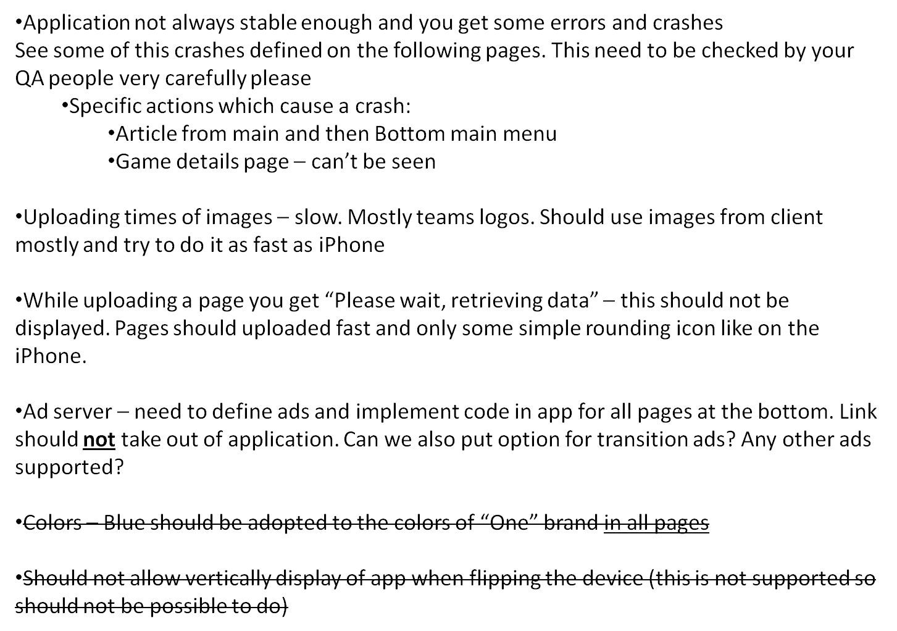
General very critical issues

Slide 2
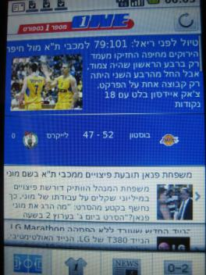
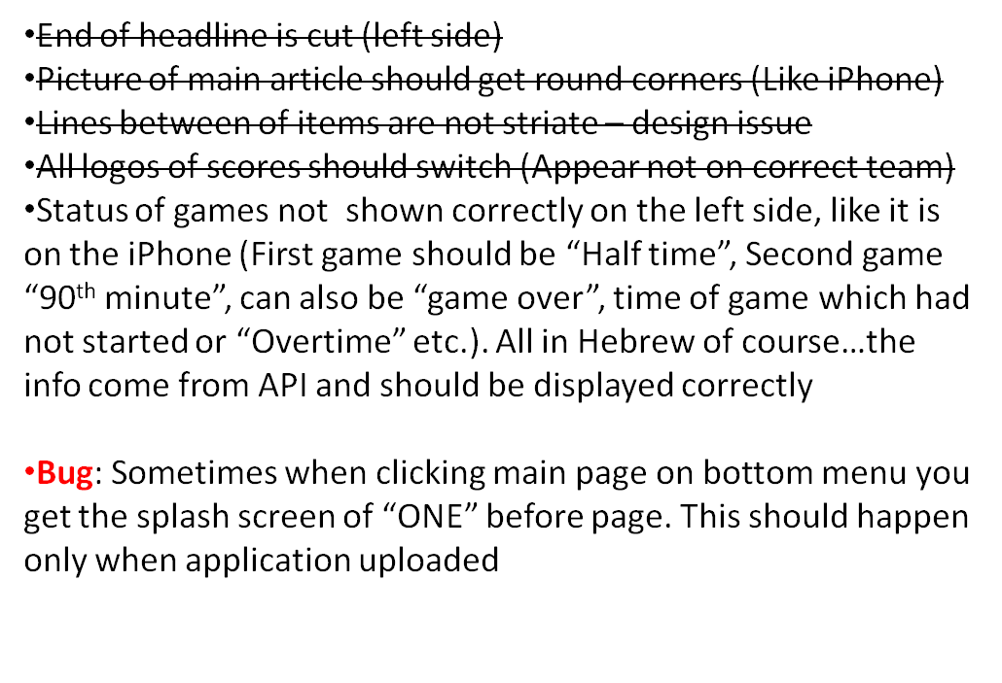
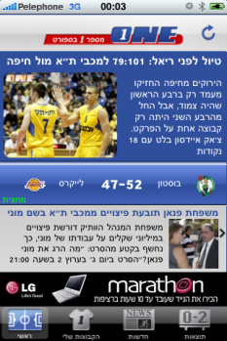
Main Page

Slide 3
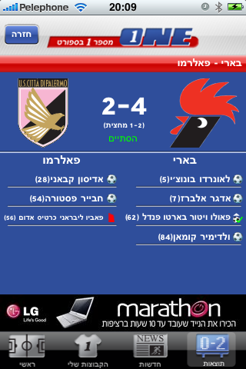
Game details page
Major Bug: not displayed – crashes application
Should be like iPhone
Red/yellow card
Panalties – in or red x for missed

Slide 4
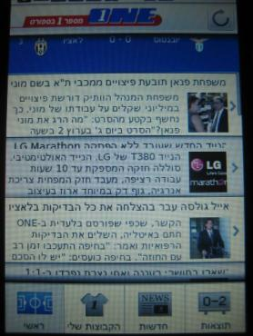
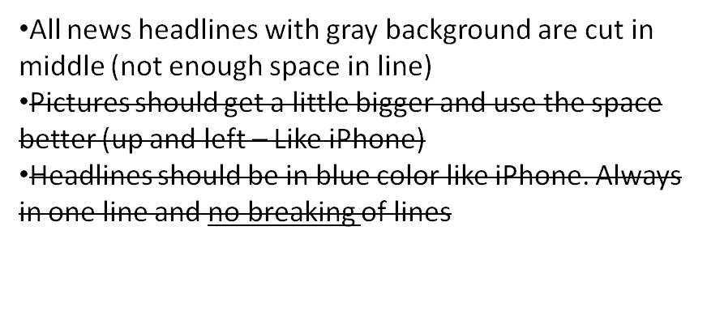
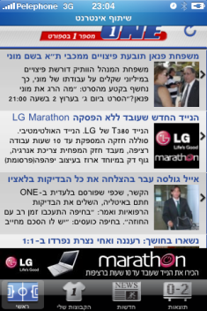
Main Page - continue

Slide 5
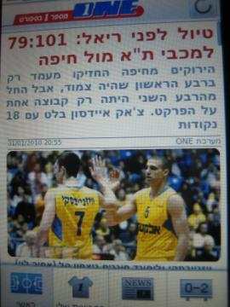
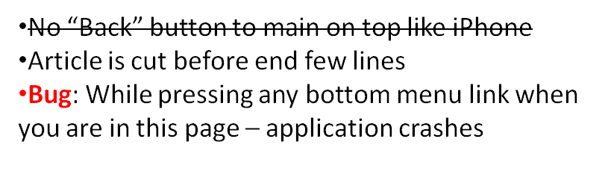
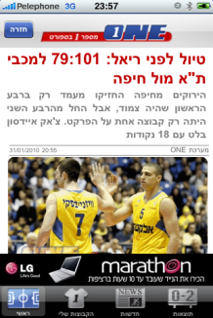
Article from Main page

Slide 6
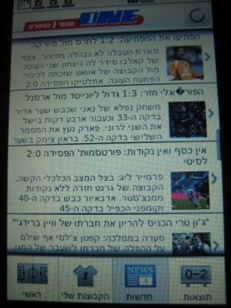
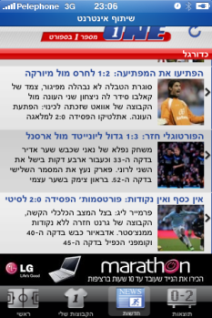
News Page
Background of items should get gray-white-gray…
Pictures should get a little bigger and use the space better (up and left – Like iPhone)
Headlines should be in bold blue color like iPhone.
Headlines Always in one line and no breaking of lines like in this case
Short description of news item should not be cut before its end
Some times Hebrew characters are not displayed and you get a strange sign instead
While scrolling – Headline of group of articles should stay on top like on iPhone

Slide 7
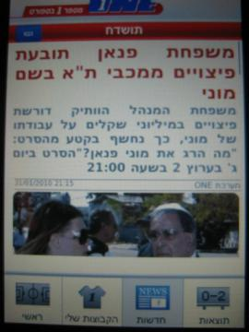
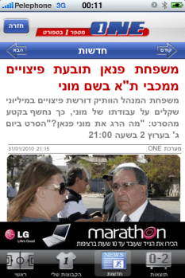
Article from NewsPage
Headline – Hebrew upside down
Article is cut before end few lines
Bug: if entering first news article and navigating to next item – no “Previous” button displayed
No “Back” button to go back to main news page

Slide 8
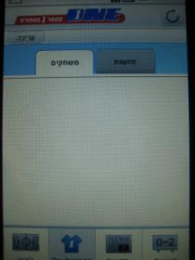
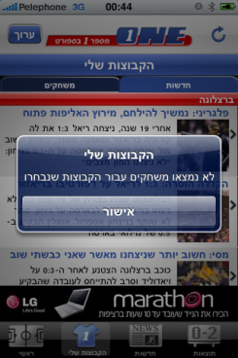
My teams page
No display of empty scores page like this
Default should be the games folder. If no games to display like in this case – News folder should open automatically.
If no news or games for selected teams – alert: “No games or News found for teams”. Keep news folder opened empty
לא נמצאו משחקים או חדשות לקבוצות שנבחרו
If no teams selected yet– alert: “please press edit to select your favorite teams”
לחץ "עריכה" לבחירת הקבוצות שלך
If no games for teams – an alert is displayed while clicking folder and access denied (like iPhone)
Alert: No games were found for your selected teams
OK
לא נמצאו משחקים עבור הקבוצות שנבחרו
אישור
iPhone screen

Slide 9
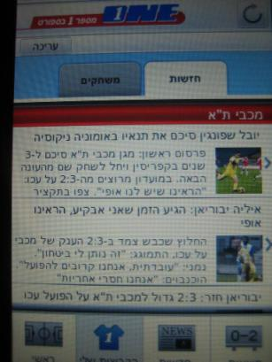
My teams page - Continue
No headline to page “My teams” like iPhone
הקבוצות שלי
Hebrew headline should be
חדשות
One letter seems to be wrong now “ז“ instead of “ד“
About display of news items – see all remarks for the news page in slides above

Slide 10
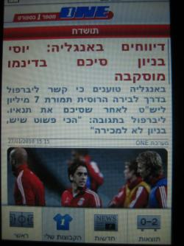
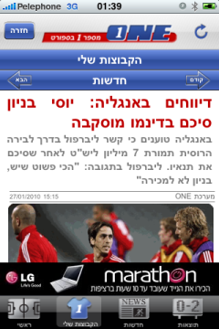
My teams page – news article
:No navigation between news articles at all like on iPhone
Headline of news – upside down Hebrew
No “My teams” Headline like iPhone
הקבוצות שלי
No “Back” button to go back to my teams like on iPhone

Slide 11
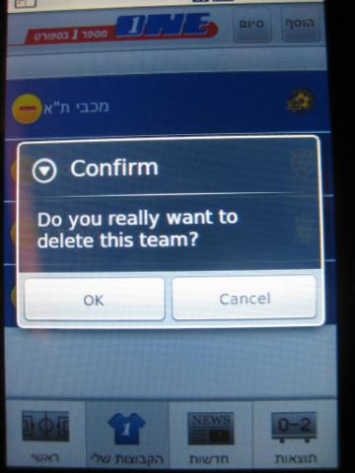
My teams- editing page
Alert when deleting a team should be Hebrew:
אשר
האם ברצונך למחוק קבוצה זו?
No headline to page “My teams” like iPhone
הקבוצות שלי

Slide 12
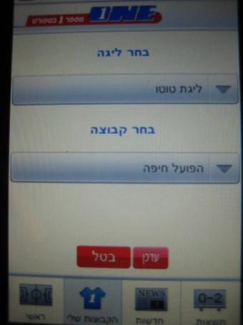
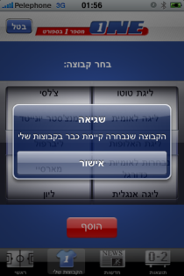
My teams- Add teams page
Only “Update” button on bottom
Cancel button should be on top like iPhone
Alert: if updating team already selected:
שגיאה
הקבוצה שבחרת קיימת כבר בקבוצות שלך

Slide 13
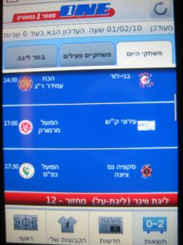
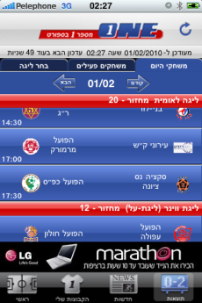
Score Board Page – games folder by dates
Page cut before the end –more games underneath not displayed and no more scrolling (See on iphone)
Upload of page still slow because of images
While scrolling – Headline of group of articles of team should stay on top like on iPhone
Page not refreshed automatically after countdown
Upper bar of navigation should not disappear when scrolling down (date+next+previuos) – See iPhone

Slide 14
Score Board Page – Select League folder
Bug: Update mechanism do not work well. not refreshing when league changed (also effects refreshing of other folders – please check carefully with QA people)

Slide 15
Score Board Page – Active games folder
Same remarks as in games by dates folder
If no active games – no enter to folder and alert
תוצאות LIVE
אין כעת משחקים פעילים

